Slide 1
Building Geography Skills
Day 8

Slide 2
Visual Literacy
Look at the following picture. Write as much as you can about what you see.

Slide 3
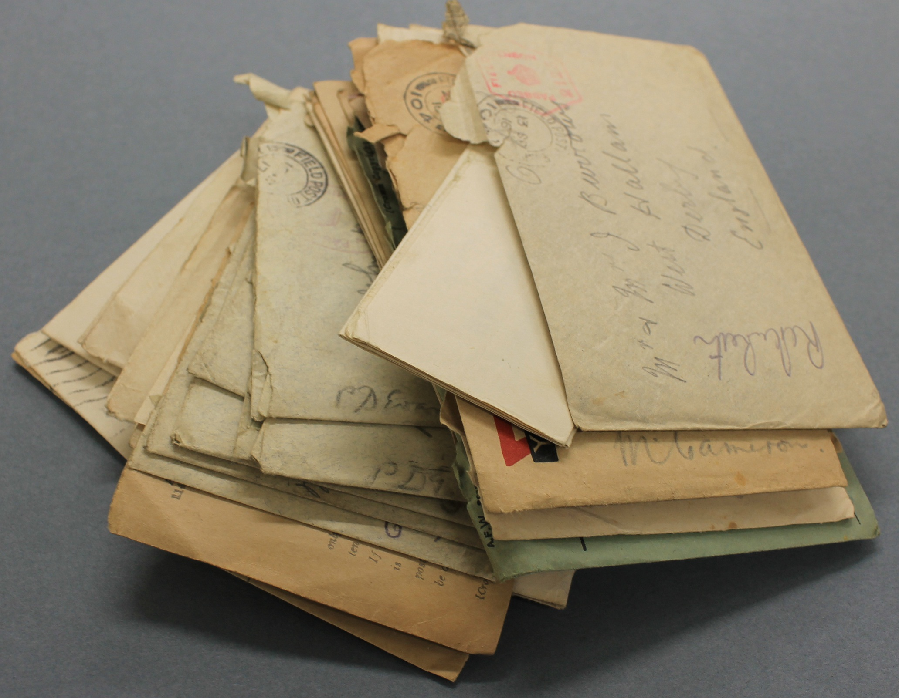

Slide 4

Visual Literacy
Share what you wrote with your partner.

Slide 5
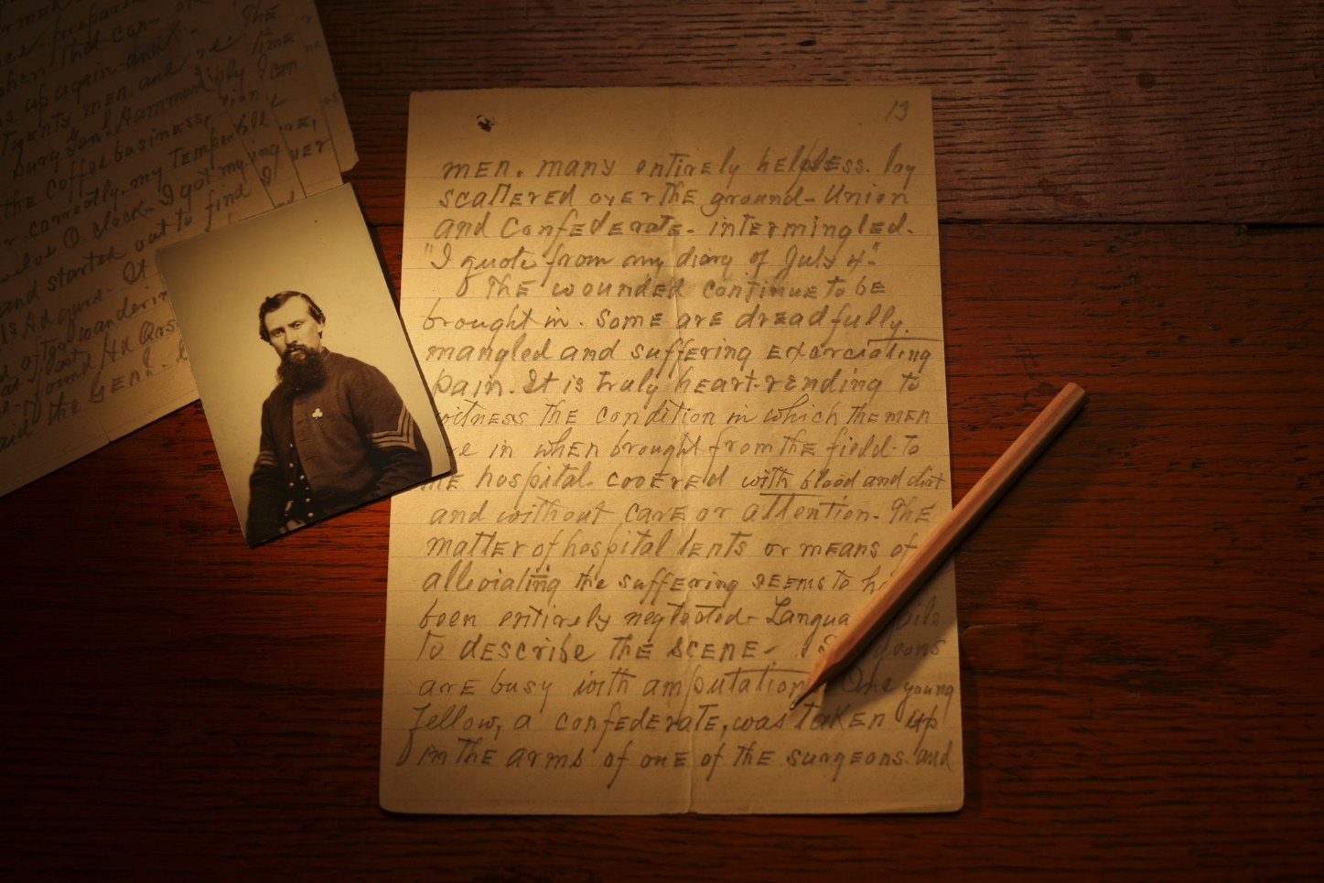
Documents that were recorded by people who were at an event and saw it or lived at that time are called primary sources.

Slide 6
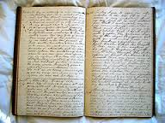
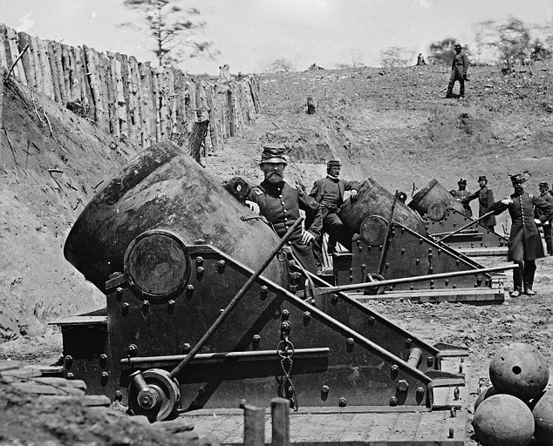
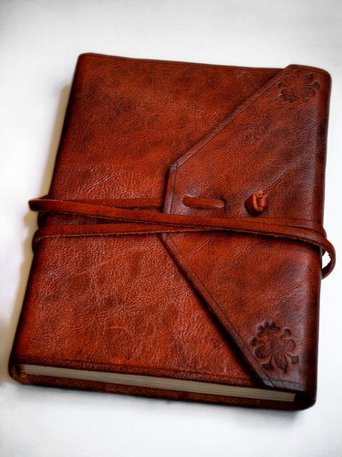
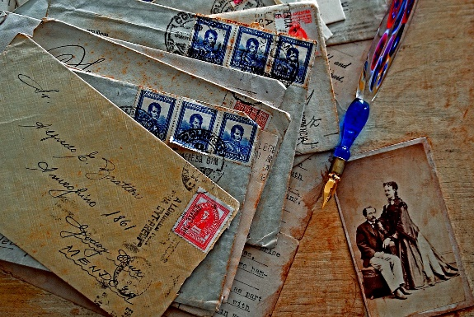
Some examples of primary sources are:
diaries
photographs
letters
journals

Slide 7
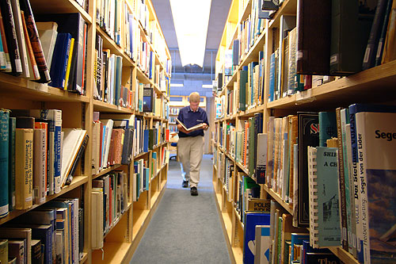
Descriptions of an event written by people who researched the event are called secondary sources.

Slide 8
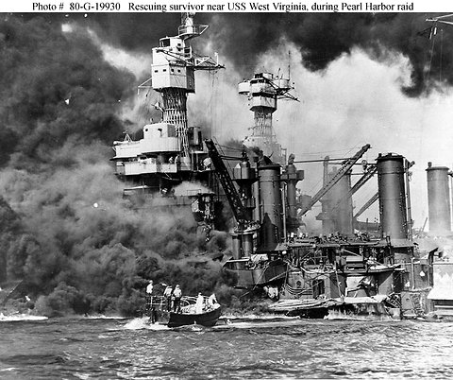
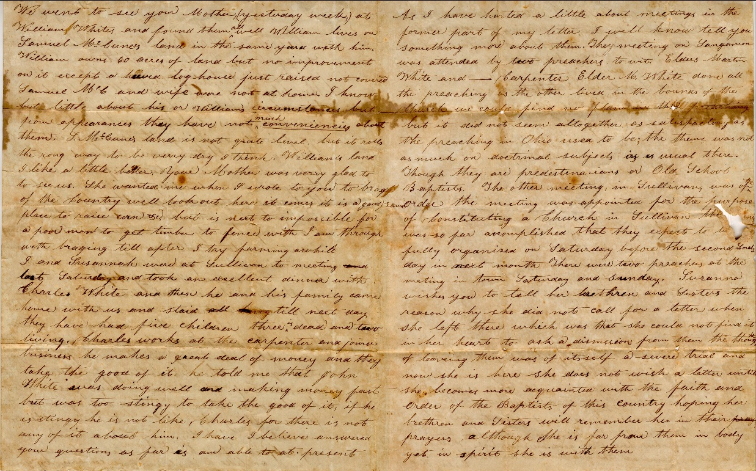
People use primary sources when creating secondary sources.

Slide 9
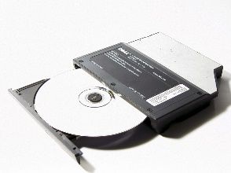




Technology resources can be used when you look for information. Some examples are:
SOFTWARE
CD ROMS
INTERNET
RADIO
TELEVISION

Slide 10

Exit Activity
Read pgs. H16-H17 and answer the questions on your outline.

